Slide 1


Technical Training Presentation Module Two
Router Setup.

Slide 2
Training Outline
Lesson 1: Setting up the Device, how to connect a router to a computer (Beginners Guide)
Lesson 1. D-Link Router Setup
Lesson 1.1 Netgear Router setup
Notes:
Lesson descriptions should be brief.

Slide 3
Objectives
By the end of this presentation you will know how to connect and Setup various types of Routers.
Notes:
Example objectives
At the end of this lesson, you will be able to:
Save files to the team Web server.
Move files to different locations on the team Web server.
Share files on the team Web server.

Slide 4
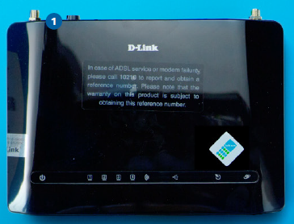
Lesson 1
Connecting a Modem / Router to a Computer
Let’s
connect
you.
D-Link DSL 2750U Router.
Netgear N300
In this beginner's article, we'll give you a step-by-step guide on how to Setup a Modem or Router.We will use examples setting up two routers from two popular suppliers.
D-Link and Netgear

Slide 5
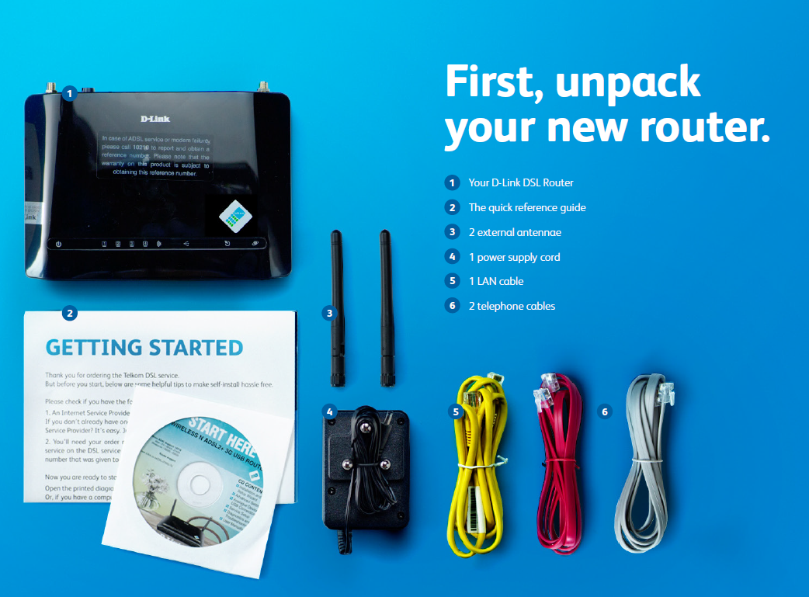
Lesson 1: Step One Connecting a Router / Modem
What’s in the box. D-Link 2750U
Check that customer has brought everything that the device was boxed with , with them.

Slide 6
Lesson 1: Lets get started – D-Link DSL 2750U
Connect the 12vDC power supply into your router and into a power socket.
Plug one end of the grey cable into the power supply port marked IN and the other end into the telephone jack on the wall.
Plug the red cable from power supply marked OUT into the red socket on the back of router marked DSL.
Plug the yellow LAN cable into the yellow port on the router and the other end into the LAN port on your computer.
2
3
1
4

Slide 7
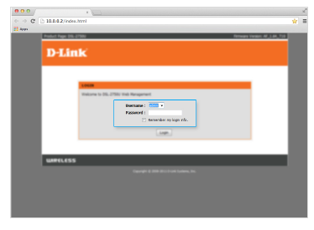
Lesson 1. Setting up the Router
Open your internet browser and go to http://10.0.0.2 and click
Enter. Type in admin for both the username and password.
Click Login.
1

Slide 8
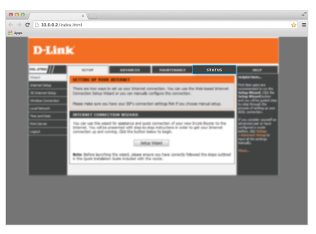
Lesson 1: Setting up the Router
2
From the D-Link page that loads click Status to see whether the router is configured.

Slide 9
Lesson 1: Setting up the Router
If your router is not online and not configured
click Setup > Setup Wizard
3

Slide 10
Lesson 1: Setting up the Router
4
Change the password to the customers preferred password. Advise the customer that they can change the password at any time.
Click Next on the Time and Date page. There is no need to change these.

Slide 11
Lesson 1: Setting up the Router
Select South Africa from the country dropdown and Telkom as your Internet
Services Provider. Enter the username and password that were SMS’d to you and click Next.
5

Slide 12
Lesson 1: Setting up the Router
6
Enter your preferred name for your
Wi-Fi network, and your password. Check
the Summary page and click Apply.

Slide 13
Lesson 1: Setting up the Router
If you were accessing the router via Wi-fi up to this
point, you will need to reconnect to the router using
the new Wi-fi name and password. It is important
to log out properly by clicking Logout.
7

Slide 14
Lesson 1: Setting up the Router
8
Activate your internet account by typing
www.telkom.co.za/verifyadsl to the address field of your
internet browser. Press Enter. Complete the fields with your
telephone number and order number and click on Submit.

Slide 15
Lesson 1.1: The Netgear Router Setup
Check that customer has brought everything that the device was boxed with , with them.
1 DSL filter
1 DSL splitter
2 telephone cables
1 LAN cable
1 power supply cord
Your Netgear N300 Router
2 external antennae

Slide 16
Lesson 1.1: The Netgear Router Setup
1
1.Connect the 12vDC power supply into your router and into a power socket.
2. Take the dark grey cable and plug the
one end into red socket marked DSL on
the DSL splitter and the other end into
the power supply port marked IN
3. Take the light grey cable and plug the
one end into the power supply port
marked OUT and the other end into the
back of the router.
4. Plug the yellow LAN cable into the yellow port on the back of the router, and the other end into the LAN port on your computer.
5. Switch your router on by pressing the power button at the back of the router.
6. Plug the short end of the DSL splitter into the telephone jack.
7. Your telephone now plugs into the green socket marked Phone of the DSL splitter.
7
2
3
4
6
5

Slide 17
Lesson 1.1: The Netgear Router Setup
The power light will first come on red then eventually turn green.
The LAN 1 light must be green if the LAN cable is plugged in.
The DSL light must stay green. If this is flashing it means that no connection is synced with exchange.
The internet light will also be green if the account is active.
The Wi-Fi light will be green if Wi-Fi is enabled.
!
All of these lights can flash as
data is transferred.
1
2
3
4
5

Slide 18
Lesson 1.1: The Netgear Router Setup
1
Open your internet browser and go to http://10.0.0.2 and click Enter. Type in admin for both the username and password.
If the router is not online, and has not been configured, click Setup, then click Setup Wizard.
Click Next.
2
3

Slide 19
Lesson 1.1: The Netgear Router Setup
4. From the Internet Connection Mod dropdown, select Use ADSL connection first and if fail use mobile broadband connection and click Next.
4

Slide 20
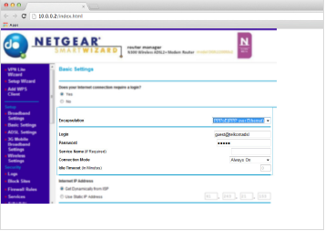
Lesson 1.1: The Netgear Router Setup
5. Select South Africa from the Country dropdown, then select No I want to configure the router myself. Click Next. On the basic settings screen, enter in the username and password that were
SMS’d to you and click Apply.
5

Slide 21
Lesson 1.1: The Netgear Router Setup
6. In the left hand navigation menu, click on Wireless Settings to configure the
Wi-Fi.
6

Slide 22
Lesson 1.1: The Netgear Router Setup
7. In the Wi-Fi Configuration page, under Wireless Network change Wi-Fi name in Name of SSID field to NETGEAR_1Meg. Under the Security Options ensure WPA2-PSK (AES) is selected.
7

Slide 23
Lesson 1.1: The Netgear Router Setup
8. Scroll down to the bottom of the page and type the password of your choice in the Password field.
Click Apply.
8

Slide 24
Lesson 1.1: The Netgear Router Setup
9. In the left hand navigation menu, under Maintenance click on Set Password. Change the current password of the Router to your preferred password and click Apply. The router may ask you to log in again using the new password.
9

Slide 25
Lesson 1.1: The Netgear Router Setup
10. It is important to log out properly by clicking Logout, and not just shutting down your browser window. Activate your internet account by opening your web browser and go to www.telkom.co.za/verifyadsl Complete the fields with your telephone number
and order number and click on Submit. You can now connect your internet-enabled
devices through Wi-Fi.
Use the same name and password you created
when you set up your DSL router.
10

Slide 26
Assessment and Evaluation
The link to a quiz to assess how much you have learned is below please complete by no later than Friday 17th August 2018 9am.
You will only have one opportunity to complete the assessment so please ensure you take your time.
The required pass mark is 90%
Right Click on the link below then click on Open Hyperlink to access the assessment.
https://docs.google.com/forms/d/e/1FAIpQLScRf6GZWzmQ_VV4w8ZI1JJDlbZZ0_P0p35QR7dz8KFgiDGEiQ/viewform?usp=sf_link

