Slide 1
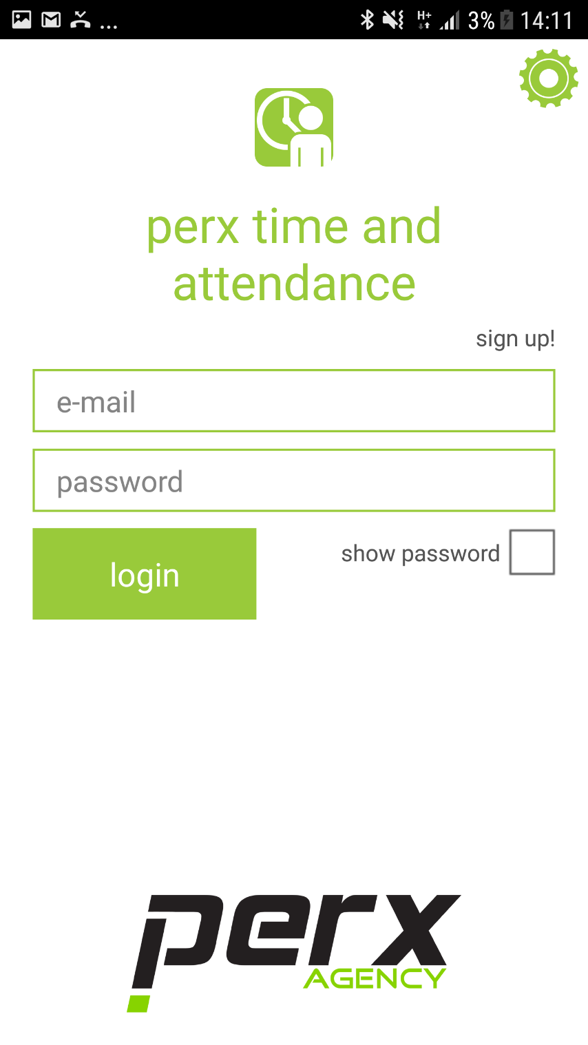
login // screen-1
Sign In using Email and Password provided by HR

Slide 2
Test Link:
https://goo.gl/forms/1xFYAzYXztkJM4r62

Slide 3
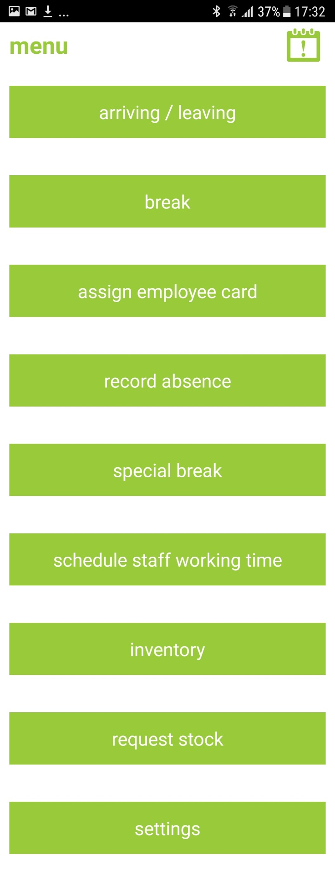
menu //
Click on any of the menu options to complete a task.

Slide 4
Assign Employee Card //
Click on assign employee card.

Slide 5
Assign Employee Card //
NFC Card.

Slide 6
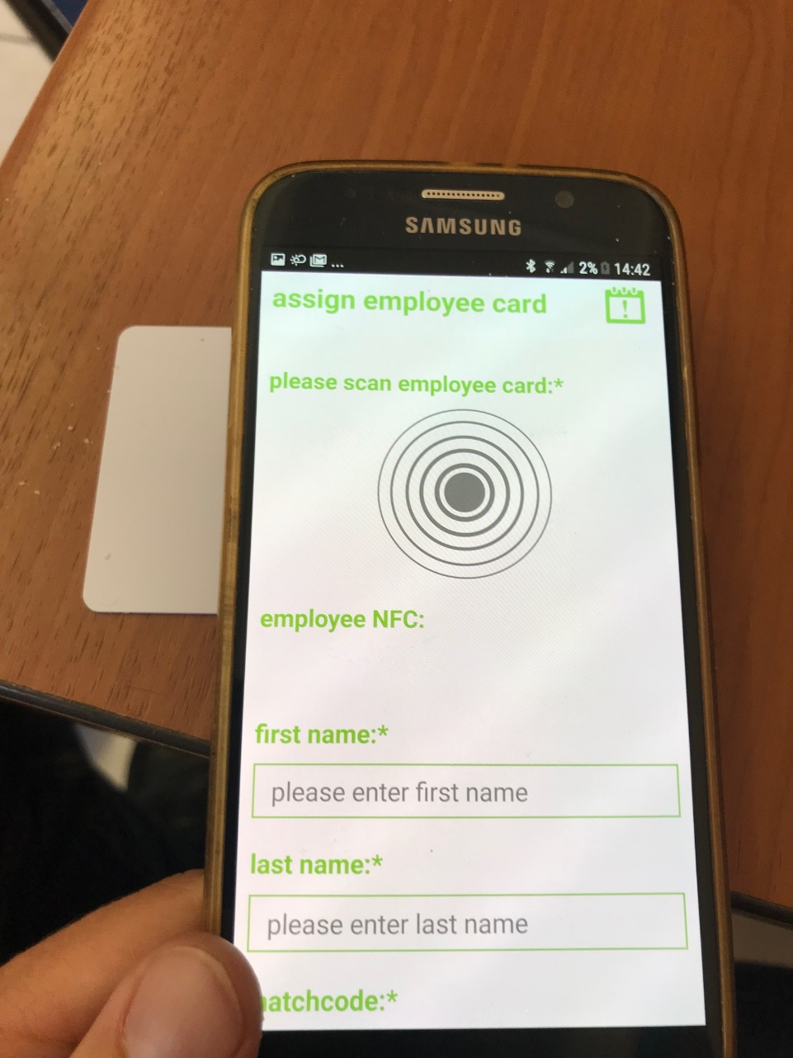
assign employee card //
Once you have clicked on assign employee card.
Now click on blank NFC Card.
Change store
Current issues

Slide 7
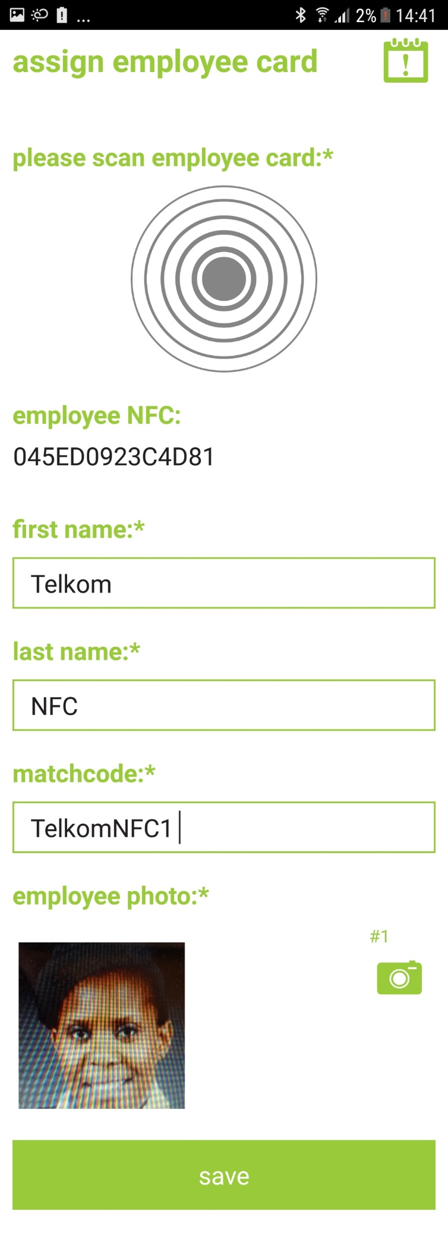
assign employee card // screen-3
Once you have tapped the blank NFC card.
Fill in the information.
Click Save.
Hand the Employee the card.
This will be the employees card for all time and attendance issues.
Change store
Current issues
Must Assign a Unique name to each employee. In case employees have the same name.
You must take a photo of the employee.
Click save to confirm . Hand NFC card to employee

Slide 8
Arriving //
When an employee arrives at work.
Click on arriving / leaving.

Slide 9
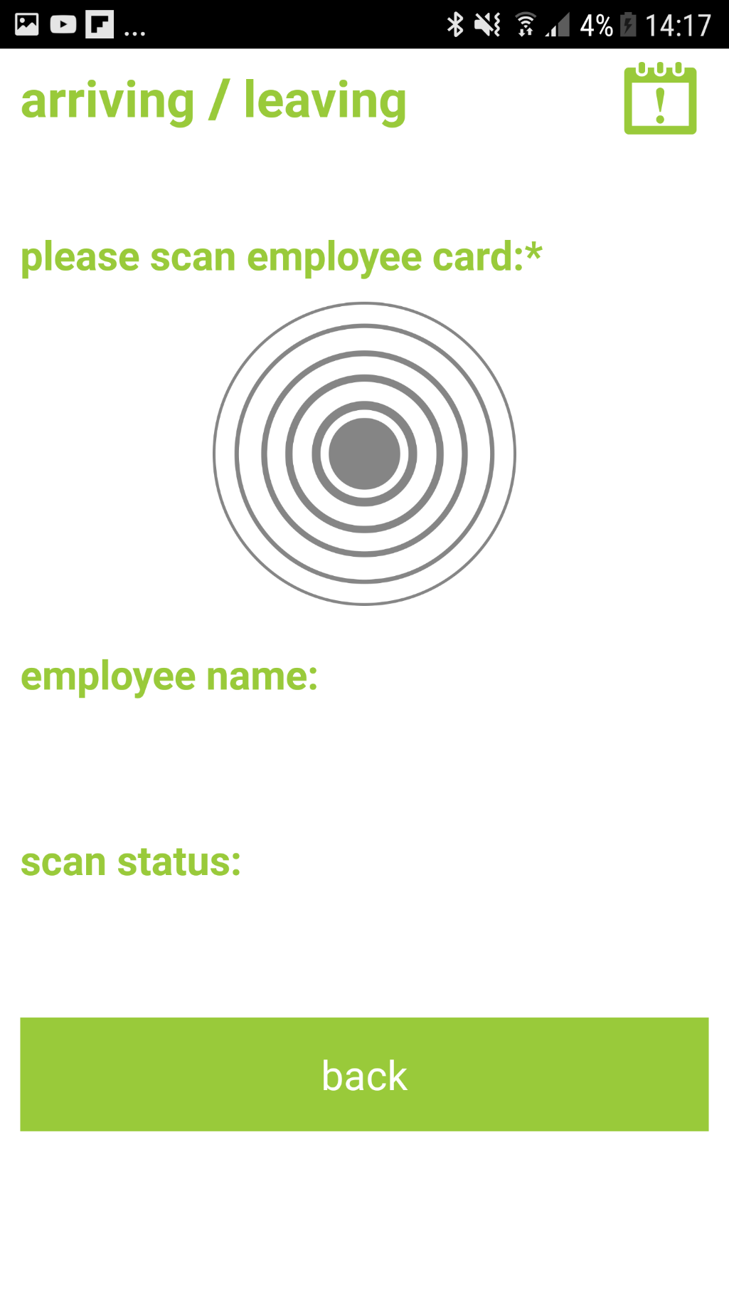
arriving //
Once you have Clicked on arriving / leaving
Now scan employees NFC card
Change store
Current issues

Slide 10
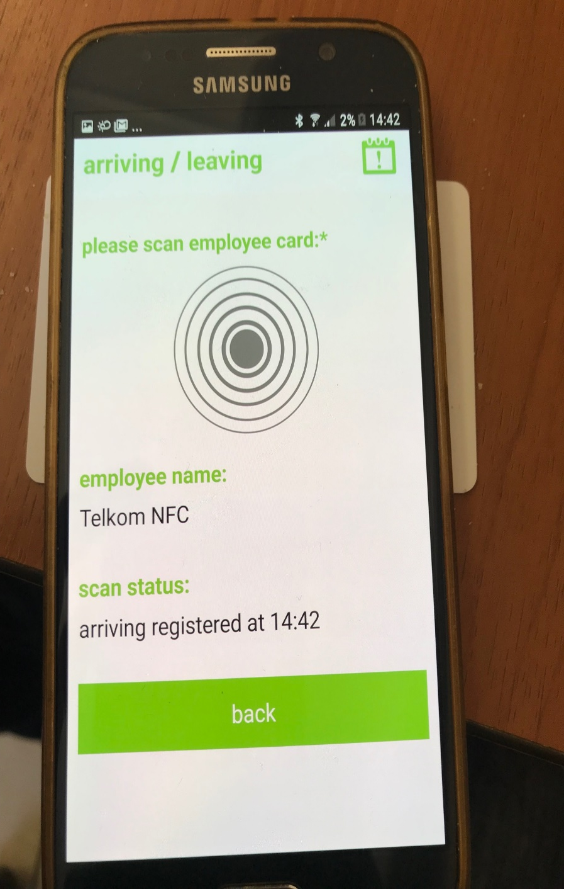
arriving //
Tap on employees NFC tag
Change store
You will see the employees name and time of arrival.
Click back to go to main menu.
Current issues

Slide 11
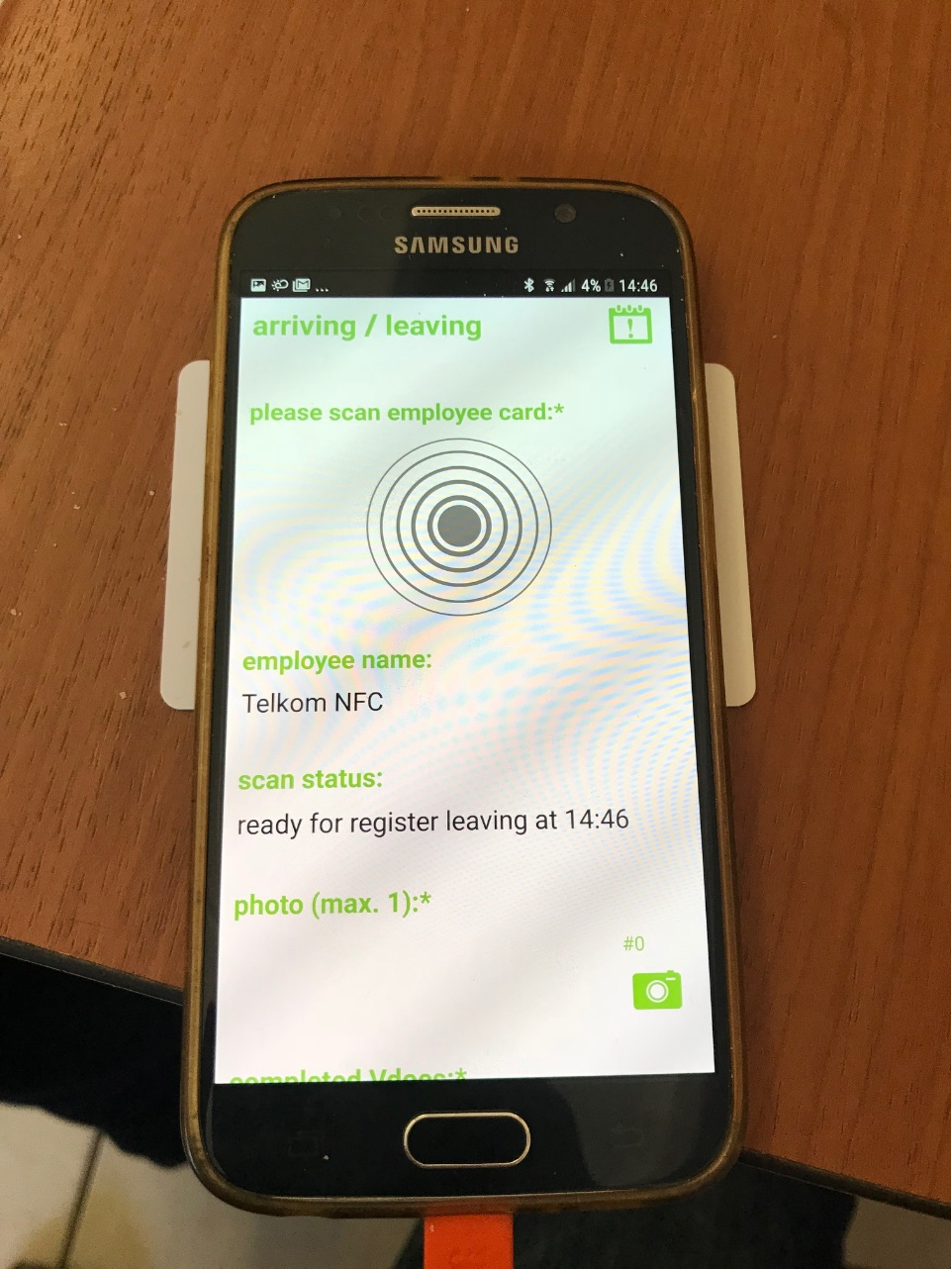
leaving //
Tap on employees NFC card
Change store
Current issues

Slide 12
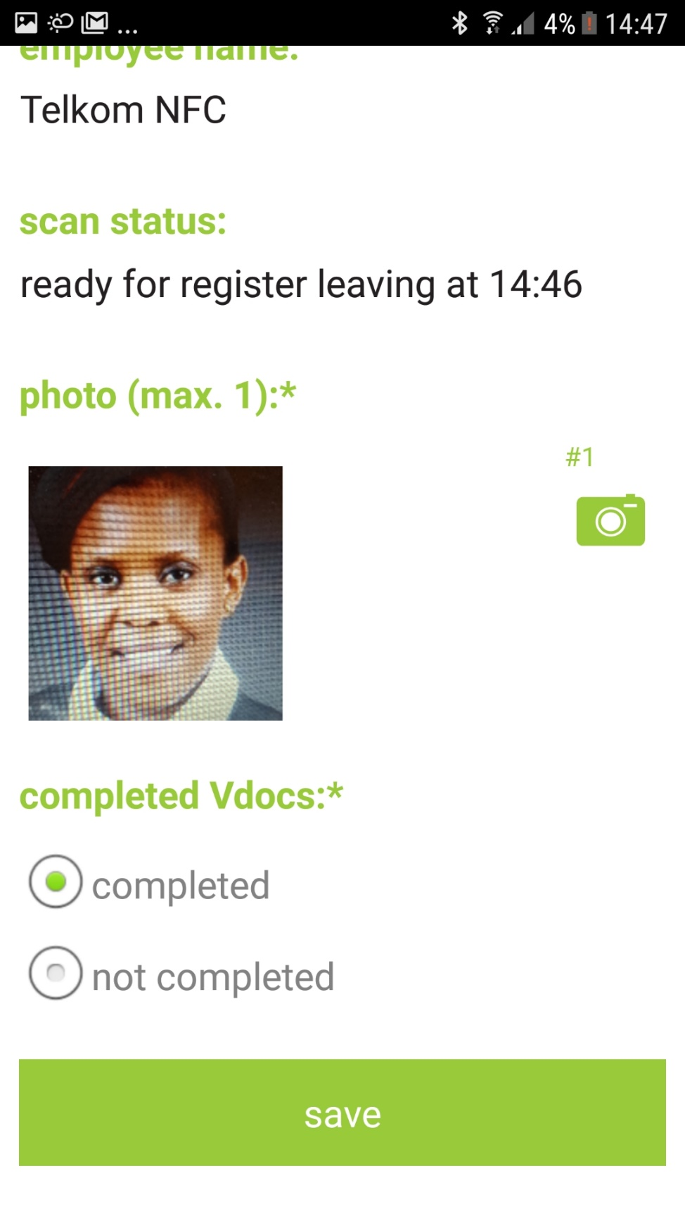
leaving //
You will see once you tap the NFC card. It registers the employees name and time of departure.
Change store
You have to take a picture of staff member to show they where at work.
Current issues
Click to indicate if Vdocs were completed .
If not leave a reason.
Click Save.

Slide 13
break // starting
When an employee goes on a break.
Click on break

Slide 14
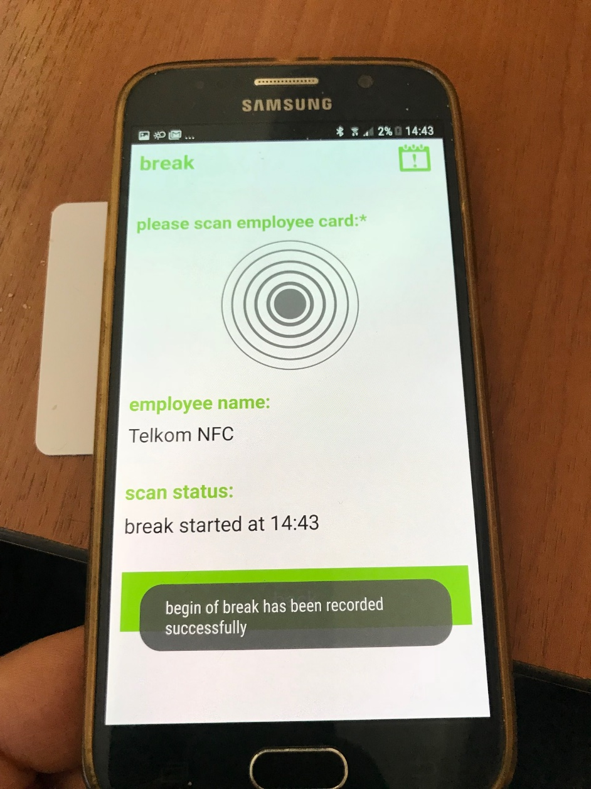
break // starting
Tap on employees NFC card.
Change store
Current issues
You will see employee has been registered for their break

Slide 15
break // ending
When an employee finishes their break.
Click on break

Slide 16
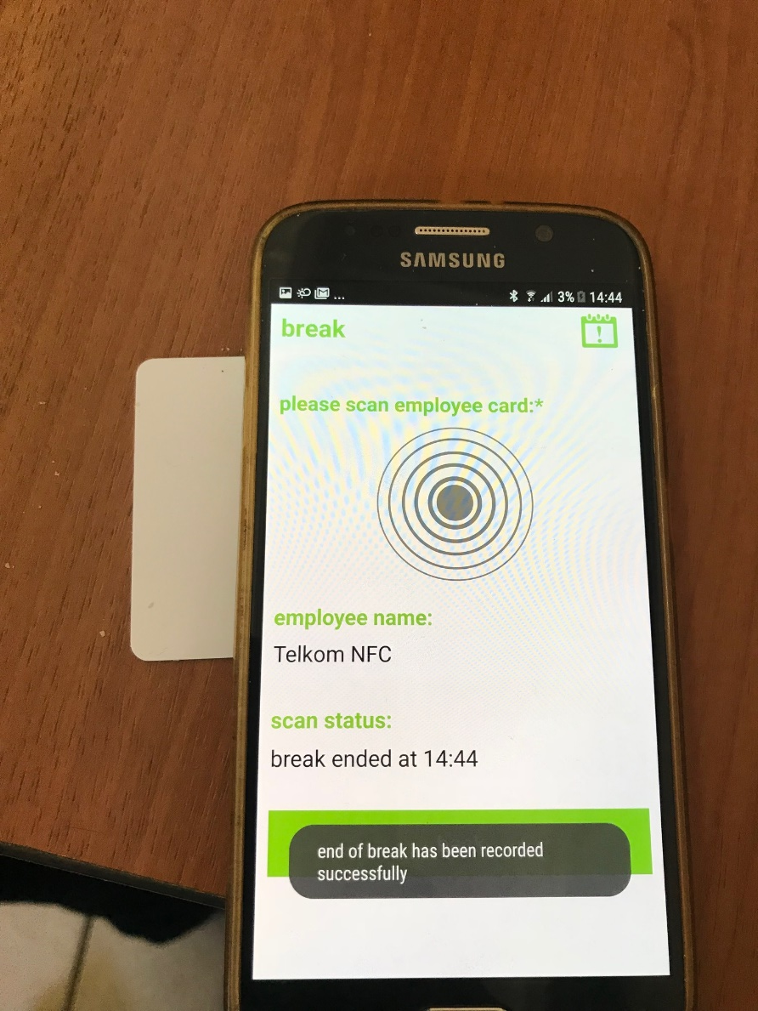
break // ending
Tap on employees NFC card.
Change store
Current issues
You will see employee has been registered for their break to end.

Slide 17
Absence //
When an employee is absent.
Click on record absence.

Slide 18
absence //
Click to select employee.
Change store
Click to select reason for absence.
Current issues
Change date for when you employee will return to work
Leave all relevant comments and click save.

Slide 19
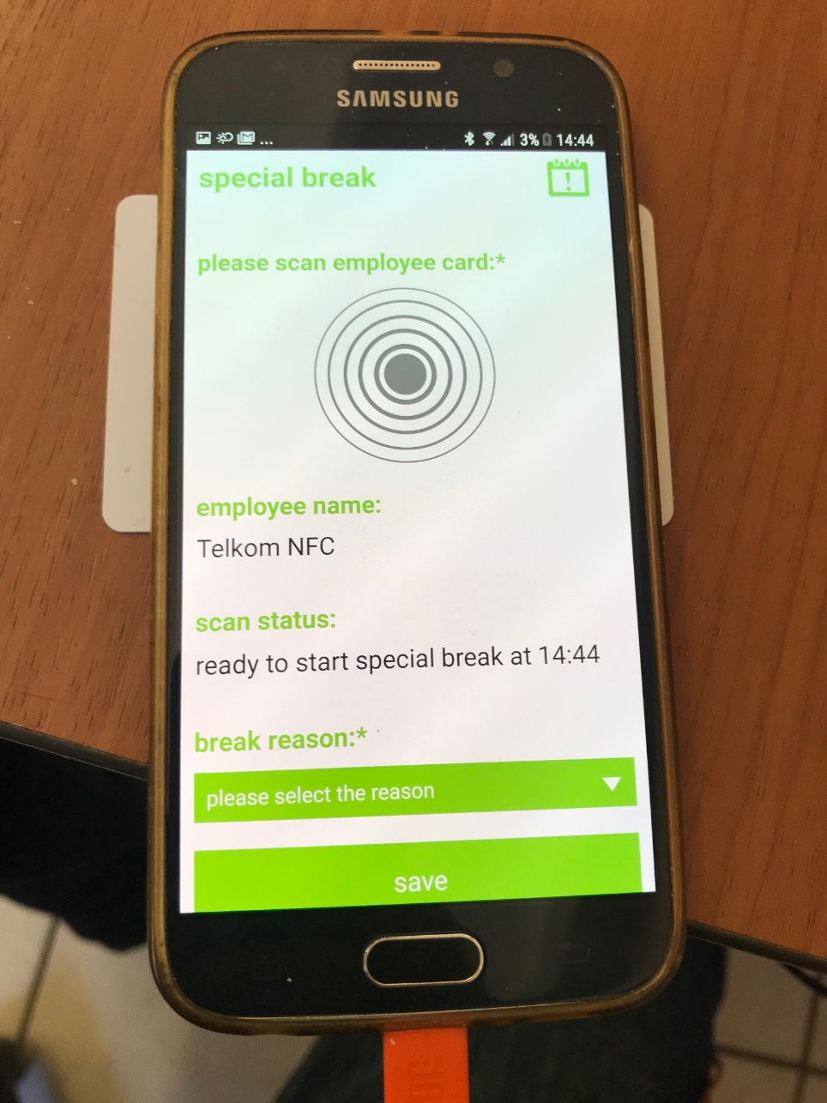
special break // starting
Tap on employees NFC card.
Change store
Current issues
You will see employee has been registered for their break to start. Click please select a reason.

Slide 20
Special Break // Starting
For an employee who want to take a special break e.g. smoke break.
Click on special break.

Slide 21
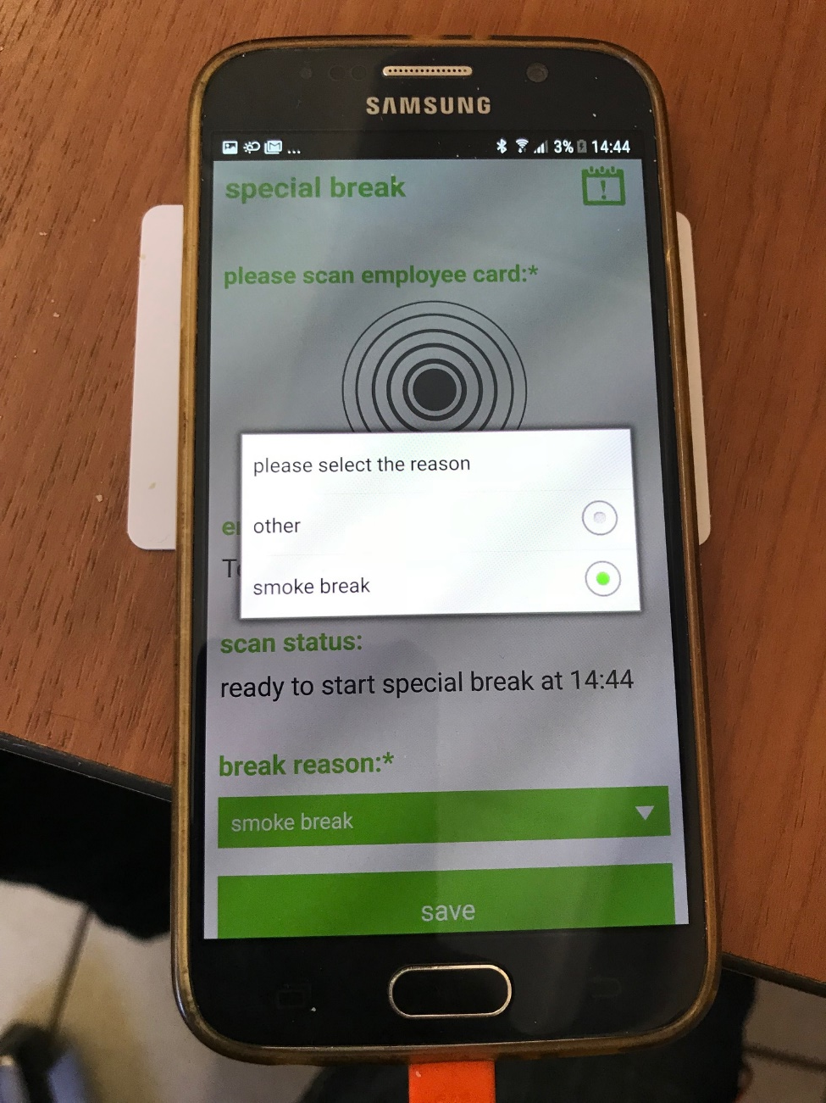
special break // starting
When you click on please select a reason.
You can either select other or smoke break.
If you select other you must leave a reason.
Click save.
Change store
Current issues

Slide 22
Special Break // Ending
When an employee returns from special break.
Click on special break.

Slide 23
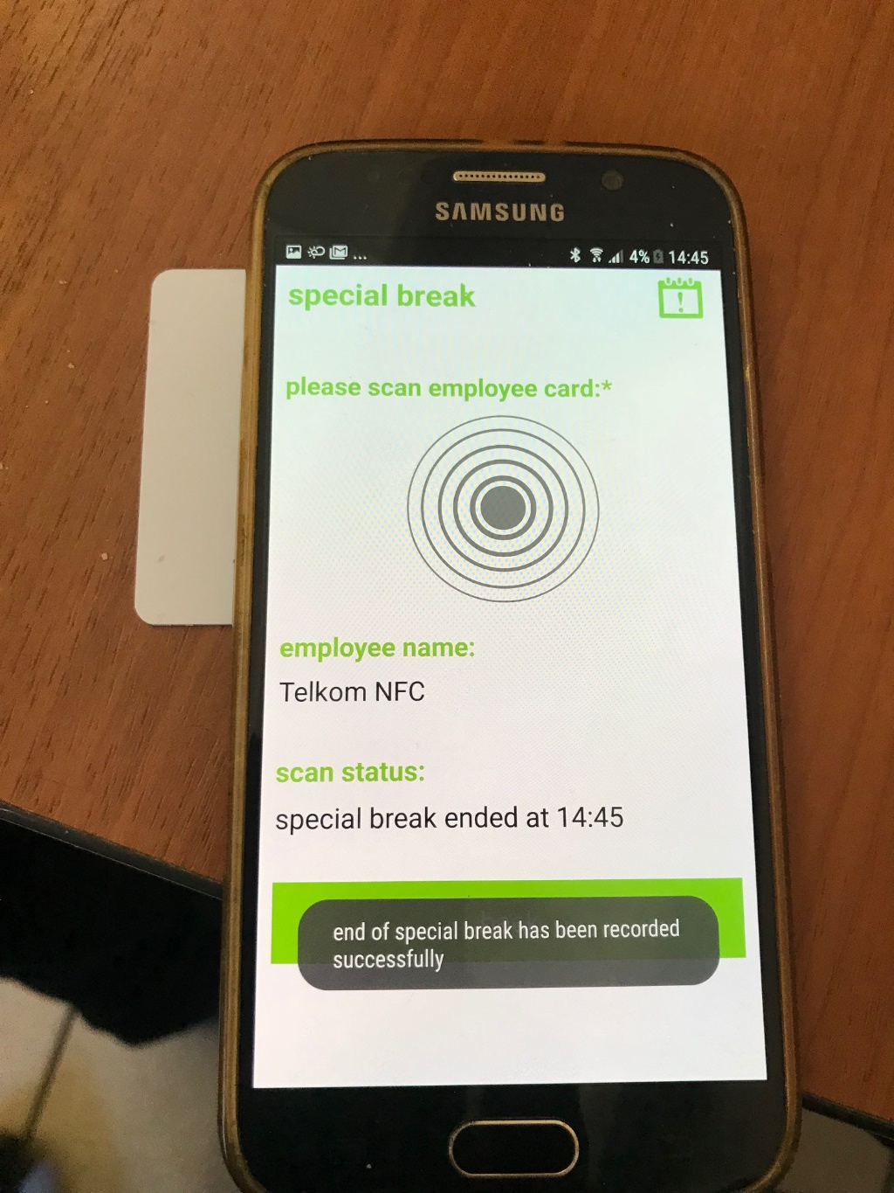
special break // ending
When employee returns from special break. Click on employees NFC card.
Change store
Current issues
You will see employee has been registered for their special break to end.

Slide 24
Schedule Working Times //
To schedule staff working times
Click on schedule staff working time.

Slide 25
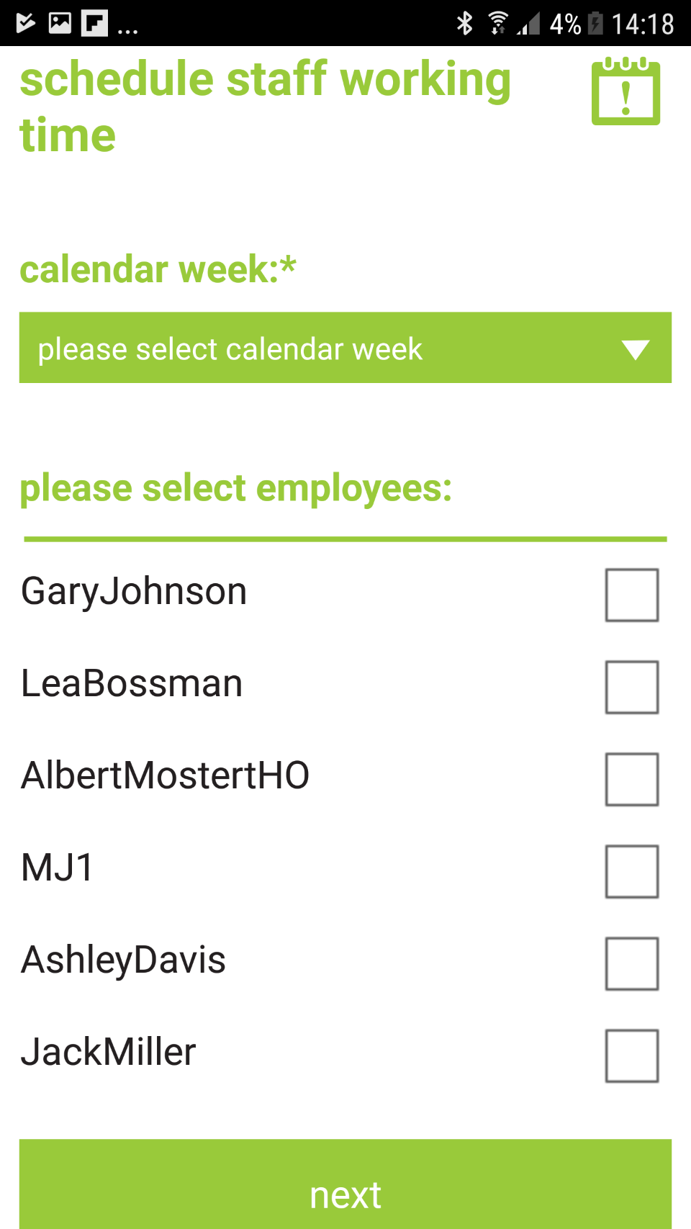
schedule working time//
Select week for scheduling
Change store
Current issues
Select employee/s you wish to schedule work for.
Click Next

Slide 26
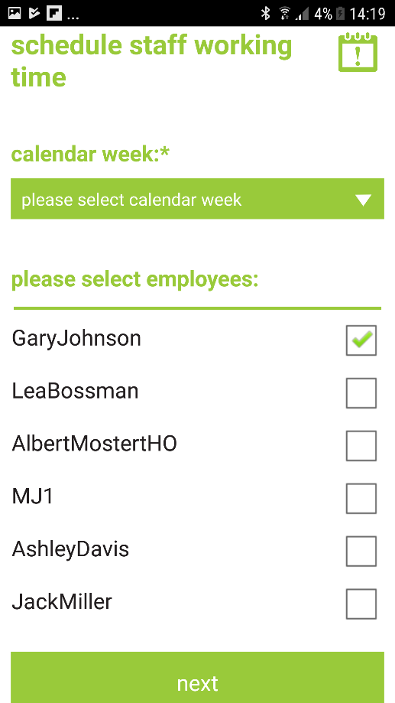
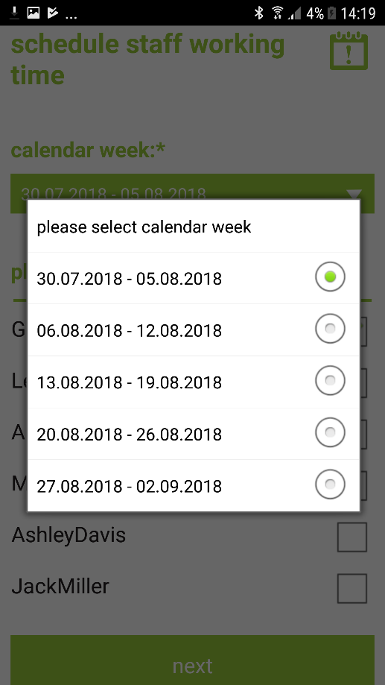
schedule working time//
Select employee/s you wish to schedule work for.
Change store
Current issues
Select week for scheduling

Slide 27
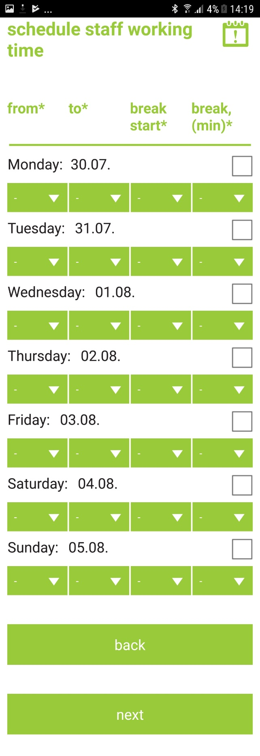
schedule working time//
Select day for scheduling,
Choose work starting time
Change store
Current issues
Choosework ending time
Choose break starting time
Choose break ending Time
Click Next to confirm

Slide 28
Inventory //
To check inventory.
Click on inventory.

Slide 29
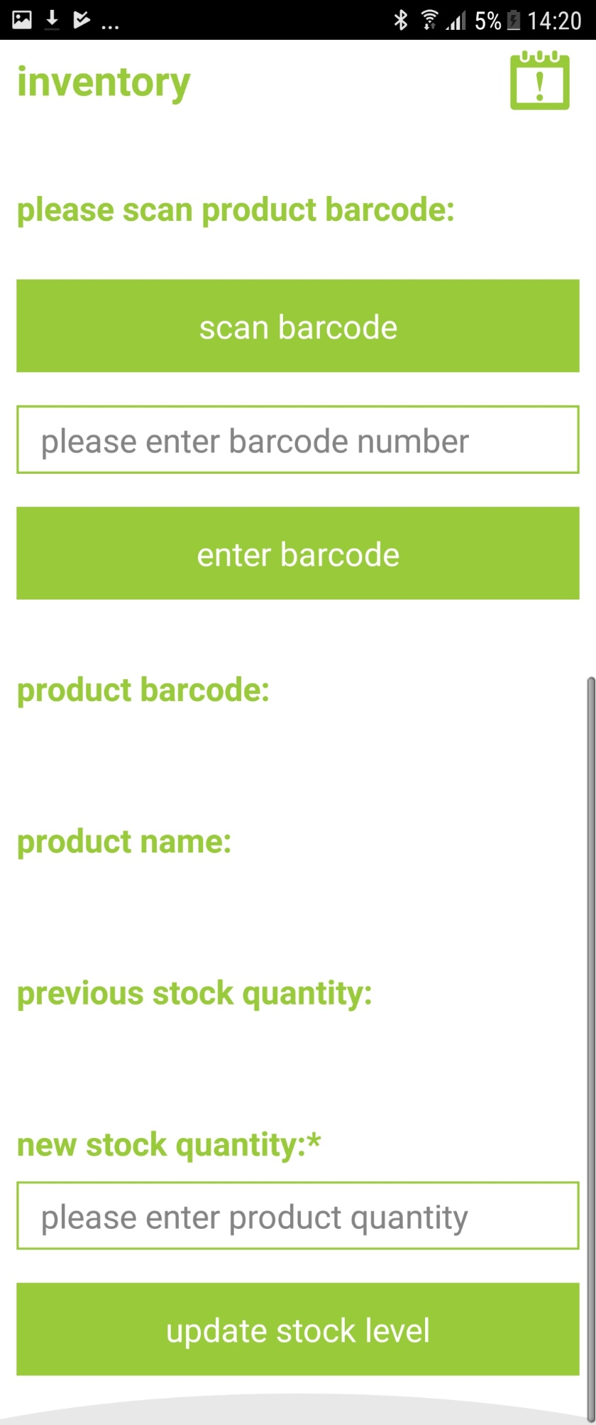
Inventory //
Click to scan bar code.
Or you can enter the bar code and the click enter barcode.
Change store
Current issues
Click update stock level to register new stock levels.

Slide 30
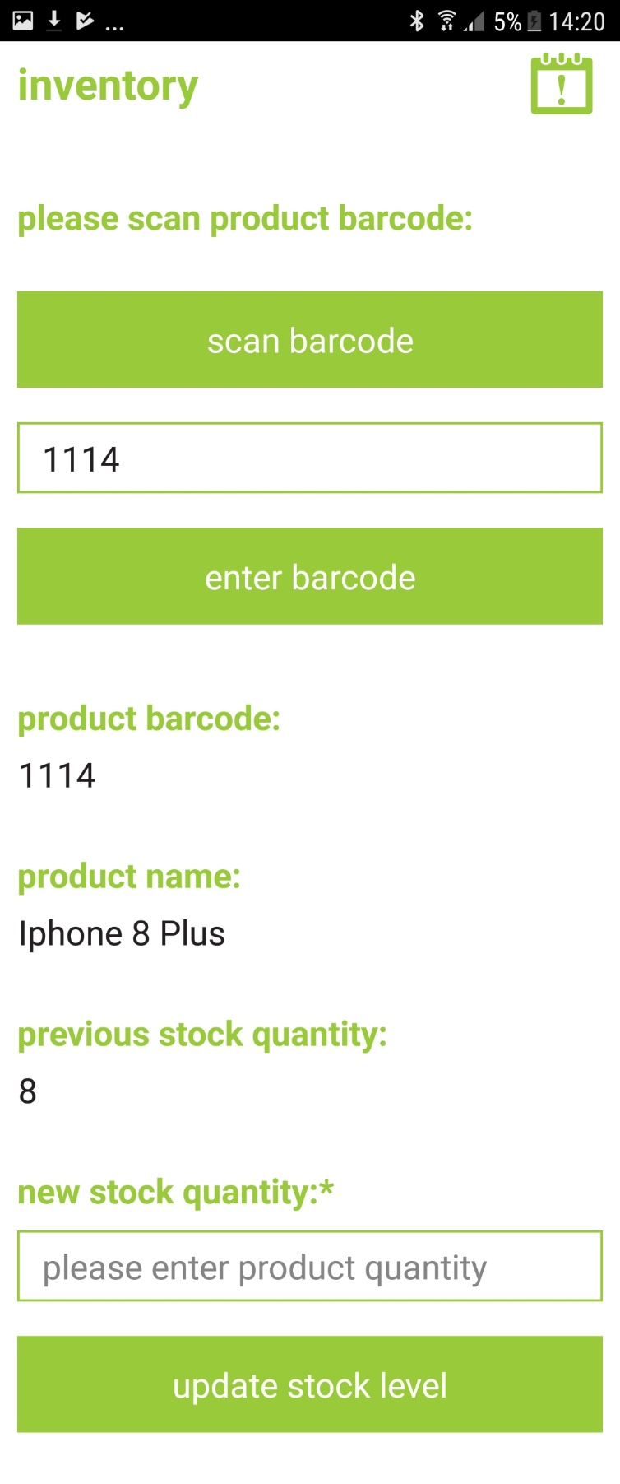
Inventory //
Change store
Current issues
Once bar code is entered product information appears.
Enter new stock level
Click update stock level to register new stock levels.

Slide 31
Request Stock //
To request stock.
Click request stock

Slide 32
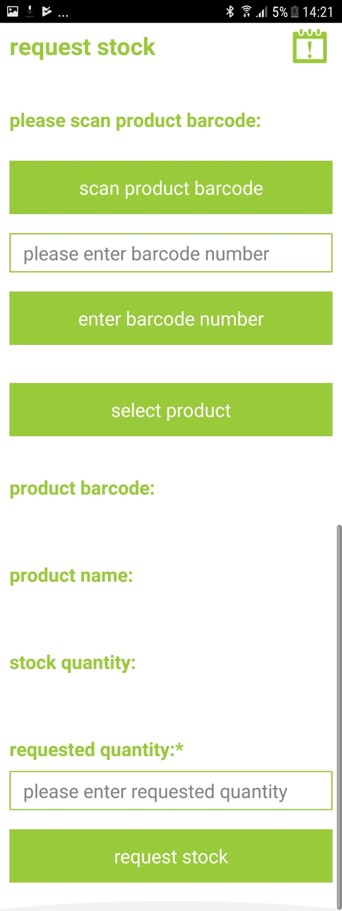
request stock //
Click to scan bar code.
Or you can enter the bar code and the click enter barcode.
Change store
Current issues
Click to request stock

Slide 33
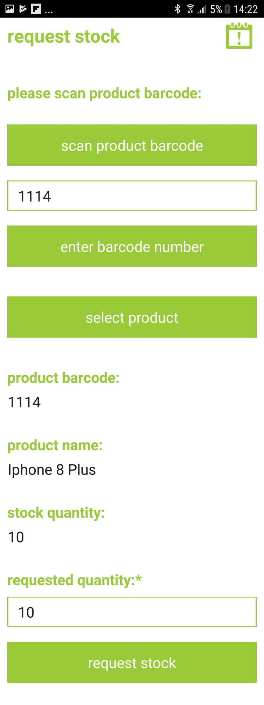
request stock //
Change store
Current issues
Once bar code is entered product information appears.
Shows stock on hand
Enter stock amount needed.
Click request stock to request stock.

Slide 34
Report an issue //
Click to report an issue.
This icon is found on all pages.

Slide 35
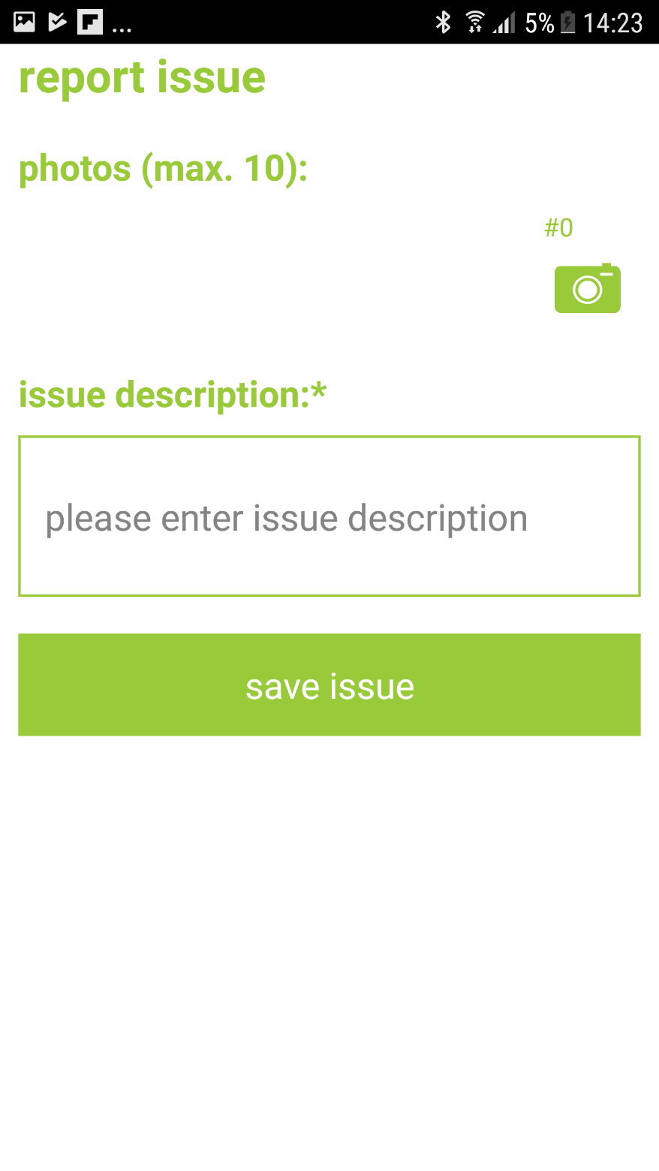
report an issue //
Click take photos of any issues.
Change store
Enter description of issue.
Current issues
Click save issue for issue to be sent to regional manager
Click to request stock

